Slide 1
Modeling Automata with Coalgebras
TOC 2019
Eric Bond
Notes:
Hello,
My name is Eric Bond and I am a fist year masters student working under professor Benjamin Delaware. My research interests are in type theory and applied type theory related to the construction of proof assistants. I chose this topic because I am currently studying F-Algebras and how they are used to construct and model inductive types and recursive functions in a functional programming language called cedille.
(examples of inductive types in a language are the natural numbers, binary trees, language syntax).
Co algebras are the mathematical dual to algebras. And in the PL community, they are used to model infinite data. However, they have been used to model automata and state based transition systems for 30+ years

Slide 2
Motivation & Background
What?
A general mathematical framework for modeling state transition systems of various types
Deterministic, Nondeterministic, Probabilistic, Quantum, …
How?
By representing these systems with variations of the same mathematical structure and building a framework around that structure.
Why?
Observe old results in a new light with a stronger toolkit.
Is this a useful encoding of systems for proof assistants?

Slide 3
High Level Idea
Components
States
Observation function
Transition function
Understand properties of systems by mapping(comparing) them to other systems
Features
Mathematical definition of behavioral equivalence
Local behavior to global behavior
Behavioral equivalence of states in a system
Behavioral equivalence of states in different systems
Yields a proof technique, Coindution (dual to structural induction)
Automata minimization
Notes:
At a high level the intuition is that we have 3 components: a black box of states, a transition function, and an observation function. These component will vary depending on the type of automata we are considering.
Rather than asking what (the
states of) coalgebras are, we will ask instead what coalgebras do. And what coalgebras
do is determined by how they interact with other coalgebras or, more formally, by the
homomorphisms between coalgebras.
Given these components, the framework can be used to make statements about what languages are accepted from a given state, what states of a system are equal via observations (bisimilar – a behavioral equivalence).

Slide 4
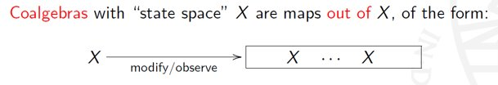


Slide 5
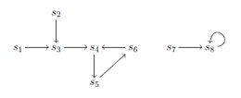


Slide 6
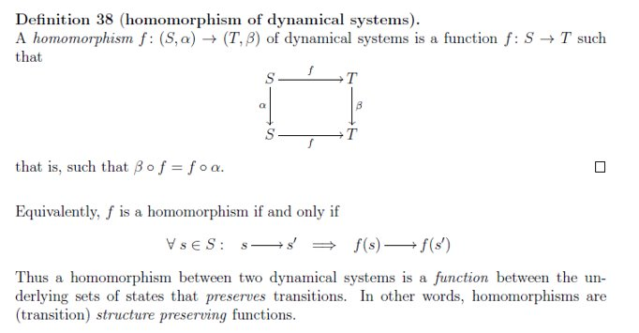

Slide 7
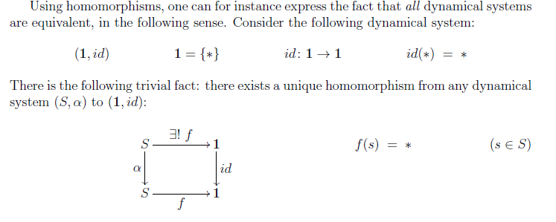

Slide 8



Slide 9
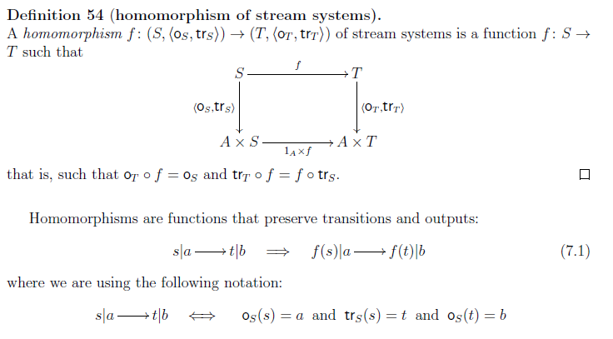

Slide 10
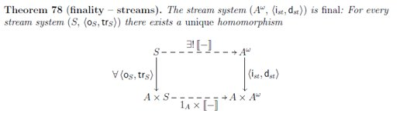

Notes:
A^w is the set of all streams
We may think of the structure map (oh,tr) as a specification of the local behavior of the stream system, consisting for each state s in S of an output o(s) and a single transition step to a next state tr(s).
i is an initial value function (head)
d is a stream derivative (tail)
The final stream system is the most general stream system
The final homomorphism [[ ]] assigns to every state s its global
behaviour, which is the stream [[s]] of all successive outputs.

Slide 11
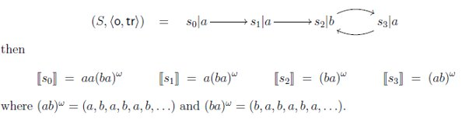

Slide 12
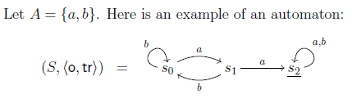



Slide 13
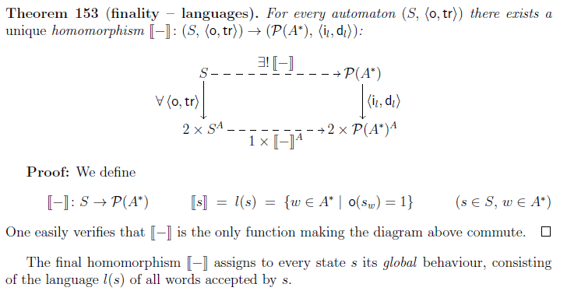

Slide 14
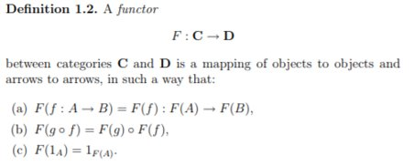

Slide 15
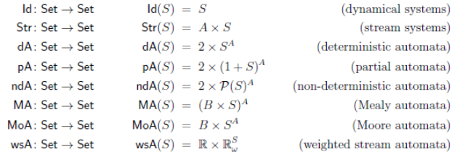
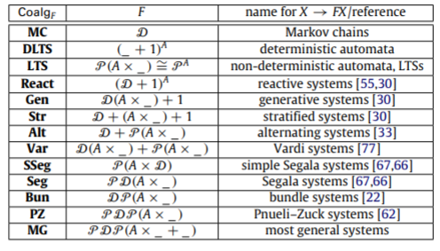
Notes:
For a fair number of these, I have seen

Slide 16
Sources
Jacobs, Bart. "Introduction to coalgebra." Towards mathematics of states and observations (2005).
Rutten, Jan. "The Method of Coalgebra: exercises in coinduction." (2019).
Sokolova, Ana. "Probabilistic systems coalgebraically: A survey." Theoretical Computer Science 412.38 (2011): 5095-5110.
Jacobs, Bart. "Bayesian Networks as Coalgebras." (2014)

